Slide 1
Supply Chain Management
ENGINEERING MANAGEMENT
Chapter# 11

Slide 2
INTRODUCTION
A supply chain is the sequence of organizations - their facilities, functions, and activities that are involved in producing and delivering a product or service.
❐ The sequence begins with basic suppliers of raw materials and extends all the way to their final customers.
❐ Facilities include warehouses, factories, processing centres, distribution centres, retail outlets, and offices.
❐ Functions and activities include forecasting, purchasing, inventory management, information management, quality assurance, scheduling, production, distribution, delivery, and customer service.

Slide 3
INTRODUCTION
Supply Chain Management is the strategic coordination of business functions within a business organization and throughout its supply chain for the purpose of integrating supply and demand management.
❐ Supply chain managers are people at various levels of the organization who are responsible for managing supply and demand both within and across business organizations.
❐ They are involved with planning and coordinating activities that include sourcing and procurement of materials and services, transformation activities, and logistics.
❐ The main actions are plan, source, make, and deliver.

Slide 4
INTRODUCTION
Logistics is the part of a supply chain involved with the forward and reverse flow of goods, services, cash, and information.
❐ Logistics management includes management of inbound and outbound transportation, material handling, warehousing, inventory, order fulfilment and distribution, third-party logistics, and reverse logistics (the return of goods from customers).
❐ Supply chains are sometimes referred to as value chains, a term that reflects the concept that value is added as goods and services progress through the chain.

Slide 5
INTRODUCTION
❐ Supply chains are the lifeblood of any business organization.
❐ They connect suppliers, producers, and final customers in a network that is essential to the creation and delivery of goods and services.
❐ Managing the supply chain is the process of planning, implementing, and controlling supply chain operations.
❐ The basic components are strategy, procurement, supply management, demand management, and logistics.
❐ The goal of supply chain management is to match supply to demand as effectively and efficiently as possible.

Slide 6
INTRODUCTION
❐ An important aspect of supply chain management is flow management.
❐ The three types of flow that need to be managed are product and service flow, information flow, and financial flow.
 Product and service flow involves the movement of goods or services from suppliers to customers, as well as handling customer service needs and product returns.
 Information flow involves sharing forecast and sales data, transmitting orders, tracking shipments, and updating order status.
 Financial flow involves credit terms, payments, and consignment and title ownership arrangements.

Slide 7
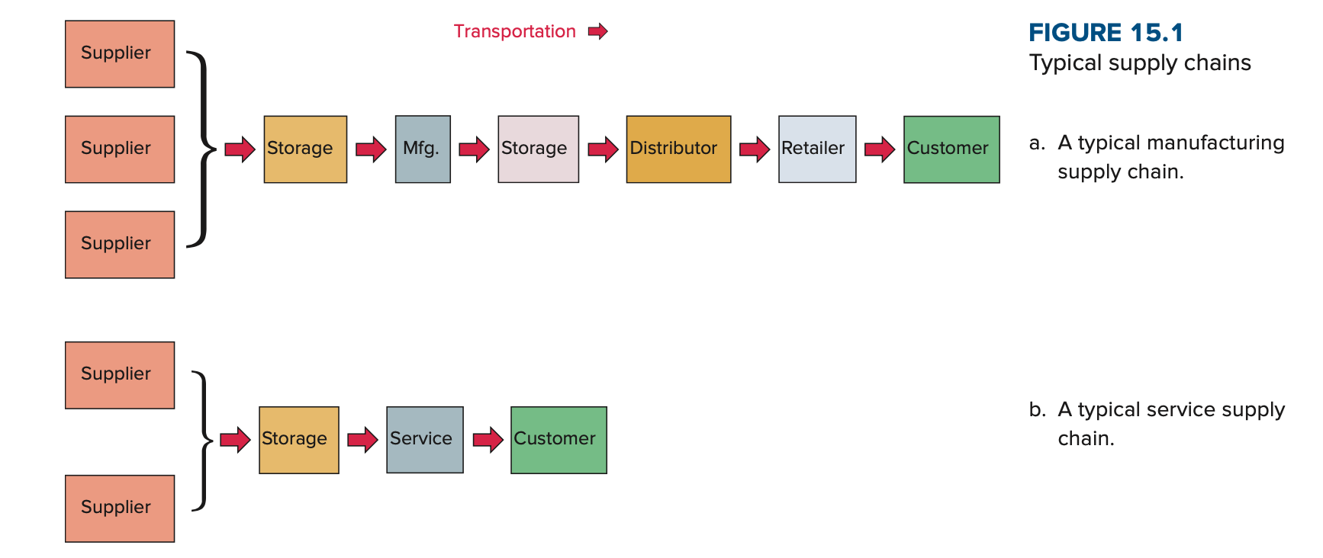
INTRODUCTION

Slide 8
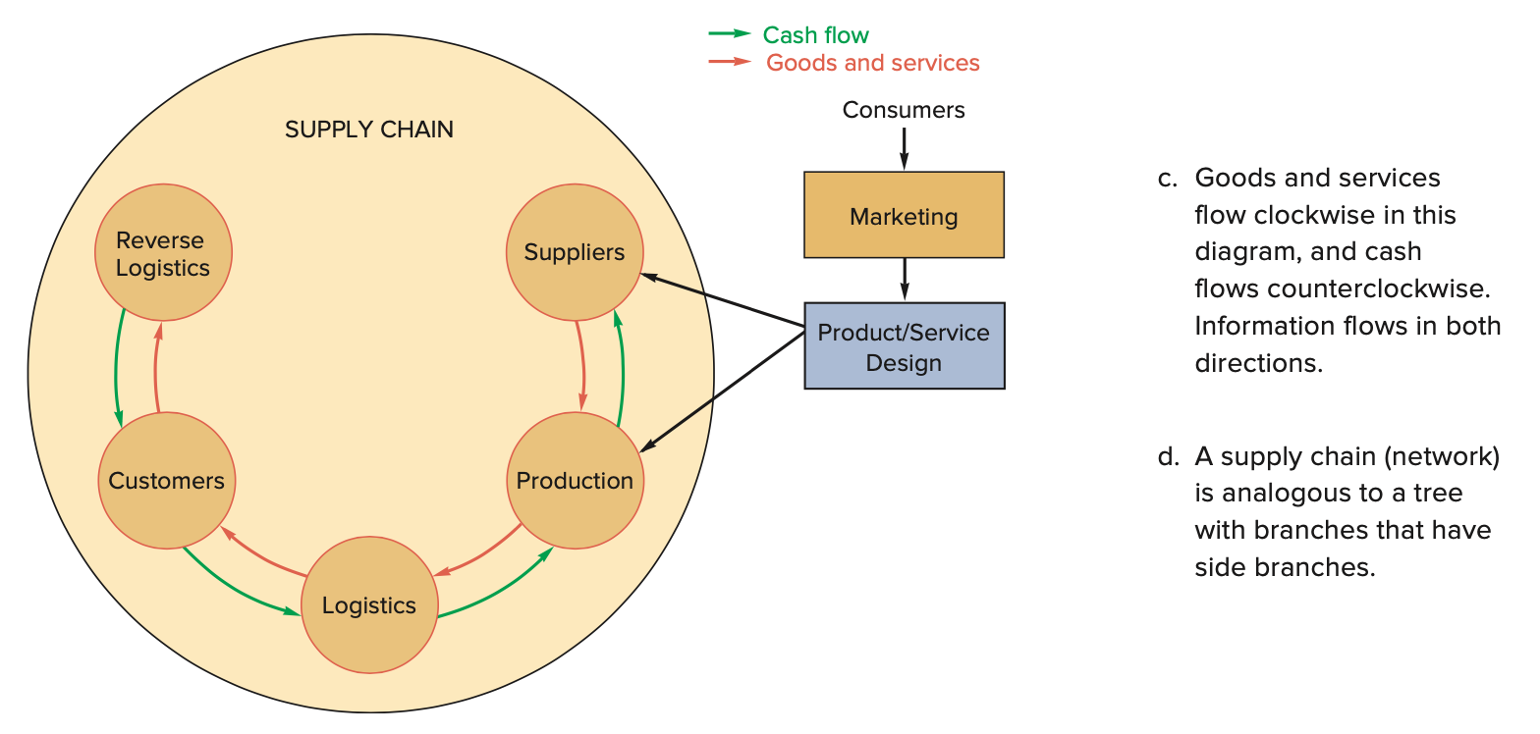
INTRODUCTION

Slide 9
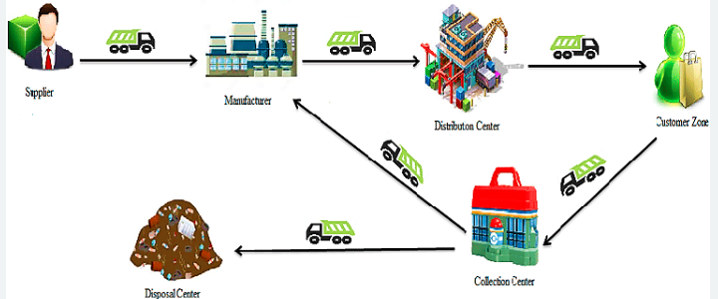
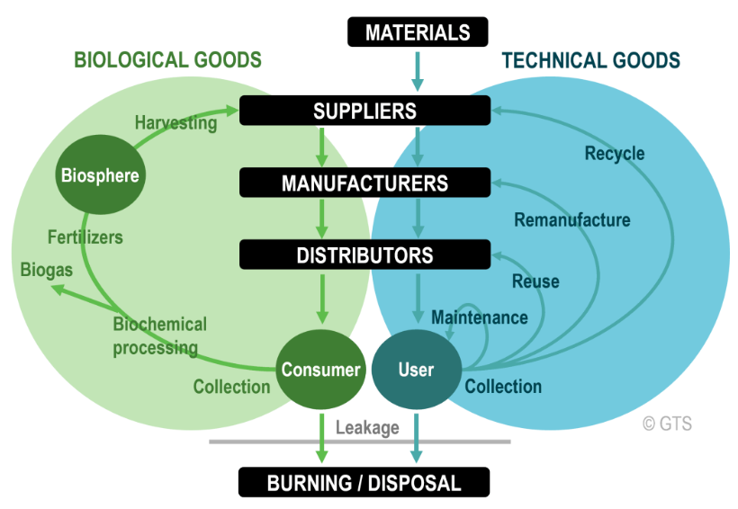
Closed loop supply chain and Circular Economy

Slide 10
Need for Supply Chain Management
 The need to improve operational efficiency
 Increasing levels of outsourcing
 Optimizing transportation costs
 Improved Competitiveness
 Increasing globalization
 Increasing importance of e-commerce
 The need to manage inventories

Slide 11
Benefits of Supply Chain Management
 Lower inventories
 Higher productivity
 Greater agility
 Shorter lead times
 Higher profits
 Greater customer loyalty
 Integrates separate organizations into a consistent operating system

Slide 12
LOGISTICS MANAGEMENT
Logistics refers to the movement of materials, services, cash, and information in a supply chain.
 Materials include all of the physical items used in a production process.
 In addition to raw materials and work in process, there are support items such as fuels, equipment, parts, tools, lubricants, office supplies, and more.
 Logistics includes movement within a facility, overseeing incoming and outgoing shipments of goods and materials, and information flow throughout the supply chain.

Slide 13
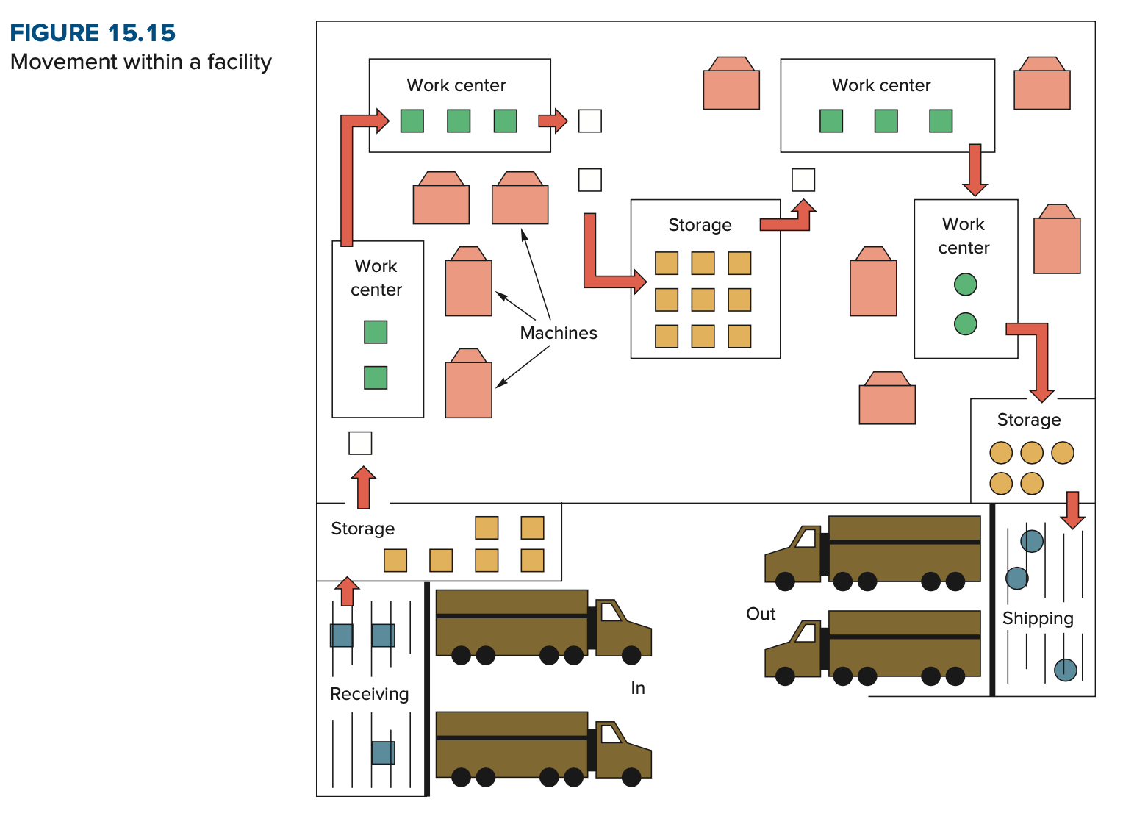
LOGISTICS MANAGEMENT
Movement within a Facility
Movement of goods within a manufacturing facility is part of production control.
The models shows the many steps where materials move within a manufacturing facility:
From incoming vehicles to receiving
From receiving to storage
From storage to the point of use (e.g., a work center)
From one work center to the next or to temporary storage
From the last operation to final storage
From storage to packaging/shipping
From shipping to outgoing vehicles

Slide 14
A Framework for Structuring Drivers
Competitive Strategy
Supply Chain Strategy
Efficiency
Responsiveness
Supply chain structure
Logistical Drivers
Facilities
Inventory
Transportation
Information
Sourcing
Pricing
Cross Functional Drivers

Slide 15
Drivers of Supply Chain Performance
Facilities
 places where inventory is stored, assembled, or fabricated
 production sites and storage sites
 Inventory
 raw materials, WIP (work in progress), finished goods within a supply chain
 inventory policies
 Transportation
 moving inventory from point to point in a supply chain
 combinations of transportation modes and routes

Slide 16
Drivers of Supply Chain Performance
 Information
 data and analysis regarding inventory, transportation, facilities throughout the supply chain
 potentially the biggest driver of supply chain performance
 Sourcing
 functions a firm performs and functions that are outsourced
 Pricing
 Price associated with goods and services provided by a firm to the supply chain

Slide 17
END OF THE CHAPTER…

